Slide 1
X86 Historical Perspective

Slide 2
Outline
Historical Perspective
Suggested reading
  Chap 3.1

Slide 3
A Historical Perspective – X86
Long evolutionary development
  Started from rather primitive 16-bit processors
  Added more features
    Take the advantage of the technology improvements
    Satisfy the demands for higher performance and for supporting more advanced operating systems
  Laden with features providing backward compatibility that are obsolete

Slide 4
X86 family
8086(1978, 29K)
  The heart of the IBM PC & DOS (8088)
  16-bit, 1M bytes addressable, 640K for users
  x87 for floating pointing
80286(1982, 134K)
  More (now obsolete) addressing modes
  Basis of the IBM PC-AT & Windows
i386(1985, 275K)
  32 bits architecture, flat addressing model
  Support a Unix operating system

Slide 5
X86 family
I486(1989, 1.9M)
  Integrated the floating-point unit onto the processor chip
Pentium(1993, 3.1M)
  Improved performance, added minor extensions
PentiumPro(1995, 5.5M)
  P6 microarchitecture
  Conditional mov
Pentium II(1997, 7M)
  Continuation of the P6

Slide 6
X86 family
Pentium III(1999, 8.2M)
  New class of instructions for manipulating vectors of floating-point numbers(SSE, Stream SIMD Extension)
  Later to 24M due to the incorporation of the level-2 cache
Pentium 4(2001, 42M)
  Netburst microarchitecture with high clock rate but high power consumption
  SSE2 instructions, new data types (eg. Double precision)

Slide 7
X86 family
Pentium 4E: (2004, 125Mtransistors).
  Added hyperthreading
    run two programs simultaneously on a single processor
  EM64T, 64-bit extension to IA32
    First developed by Advanced Micro Devices (AMD)
    x86-64
Core 2: (2006, 291Mtransistors)
  back to a microarchitecture similar to P6
  multi-core (multiple processors a single chip)
  Did not support hyperthreading

Slide 8
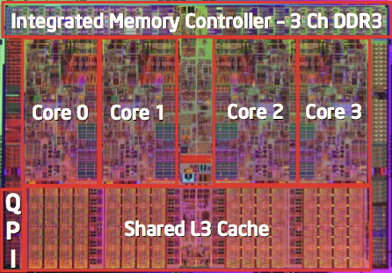
X86 family
Core i7: (2008, 781 M transistors).
  Incorporated both hyperthreading and multi-core
  the initial version supporting two executing programs on each core
Core i7: (2012, 2.2B transistors, Sandy Bridge-EP)
  8 cores on each chip
  2.7G (3.3G)
  AVX an extension of SSE to support 256-bit vector
Core i7: (2015, 5.5B transistors, Haswell-EP)
  18-core Xeon
  Extended AVX to AVX2
Xeon Platium 8170(2017, 26cores,2.10(3.7)GHz, 35.75MB L3)

Slide 9
X86 family
Advanced Micro Devices (AMD)
  At beginning,
    lagged just behind Intel in technology,
    produced less expensive and lower performance processors
In 1999
  First broke the 1-gigahertz clock-speed barrier
In 2002
  Introduced x86-64
  The widely adopted 64-bit extension to IA32

Slide 10
Moor’s Law

Slide 11
Our Coverage
IA32
  The traditional x86
  shark> gcc –m32 hello.c
x86-64
  The standard
  shark> gcc hello.c
  shark> gcc –m64 hello.c

Slide 12
Characteristics of the high level programming languages
Abstraction
  Productive
  reliable
Type checking
As efficient as hand written code
Can be compiled and executed on a number of different machines

Slide 13
Characteristics of the assembly programming languages
Managing memory
Low level instructions to carry out the computation
Highly machine specific

Slide 14
Why should we understand the assembly code
Understand the optimization capabilities of the compiler
Analyze the underlying inefficiencies in the code
Sometimes the run-time behavior of a program is needed

Slide 15
From writing assembly code to understand assembly code
Different set of skills
  Transformations
  Relation between source code and assembly code
Reverse engineering
  Trying to understand the process by which a system was created
    By studying the system and
    By working backward

Slide 16
Understanding how compilation systems works
Optimizing Program Performance
Understanding link-time error
Avoid Security hole
  Buffer Overflow

Slide 17
Operand specifiers

Slide 18
C constructs
Variable
  Different data types can be declared
Operation
  Assignment, Arithmetic expression evaluation
control
  Loops
  Procedure calls and returns

Slide 19
Code Examples
//C code long mult2(long, long); void multstore(long x, long y, long *dest) { long t = mult2(x, y); *dest = t; }

Slide 20
Source Code and Assembly Code
//C code long mult2(long, long); void multstore(long x, long y, long *dest) { long t = mult2(x, y); *dest = t; }
Obtain with command gcc –Og -S mstore.c | Assembly file mstore.s multstore: pushq %rbx movq %rdx,%rbx call mult2 movq %rax, (%rbx) popq %rbx ret
instruction
movq %rax, (%rbx)

Slide 21
From C Codes to Assembly codes
Instruction
  Performs a very elementary operation only
assign one signed integer to a content of a pointer
  C code:
    *dest = t;
  Assembly code:
    movq %rax, (%rbx)
    move a 8-byte integer (%rax) to an address ((%rbx))

Slide 22
Operands
In high level languages
  Either constants
  Or variable
Example
  *dest = t + 4
variable
constant

Slide 23
Assembly Code
Operands:
  t: Register %rax
  *dest: Memory M[%rbx]
  4: Immediate $4
  movq %rax, (%rbx) // *dest = t ;
  addq $4, (%rbx) // *dest += 4 ;

Slide 24
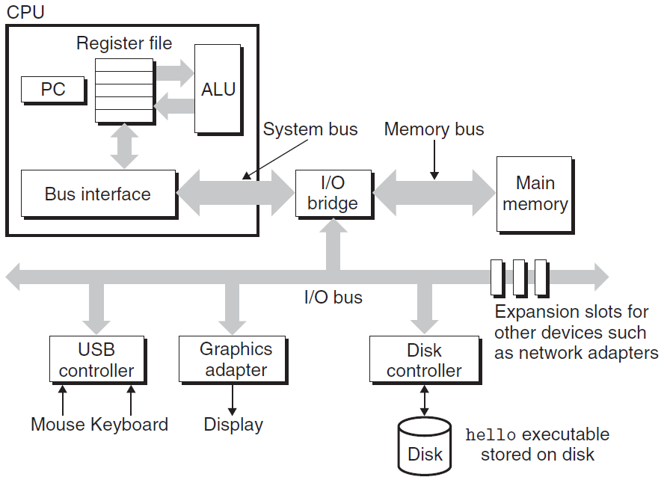
IA-64
Register
Memory
  Registers:
  The fastest storage units in computer systems, typically 64-bit long
Disk

Slide 25
READ/WRITE operations
Two important concepts
  Name and value
WRITE(name, value) value ← READ(name)
WRITE operation specifies
  a value to be remembered
  a name by which one can recall that value in the future
READ operation specifies
  the name of some previous remembered value
  the memory device returns that value

Slide 26
Registers vs. Virtual Memory
How to name registers
  Using specific names,
  For example, in IA-64
    %rax, %rcx, %rdx, %rbx, %rsi, %rdi, %rsp, %rbp
    %r8, %r9, %r10, %r11, %r12, %13, %r14, %r15
How to name virtual memory
  Using address as we have studied
What’s the difference
  Accessing values in Registers is fast
  Number of the registers is small
  Most modern instructions can access registers only

Slide 27
Where are the variables? — registers & Memory
0xffffffffffff
0xfffffffffffe
0x2
0x1
0x0
… … …
16 integer registers
8-byte long
addresses
contents
16 floating point registers
32-byte long

Slide 28
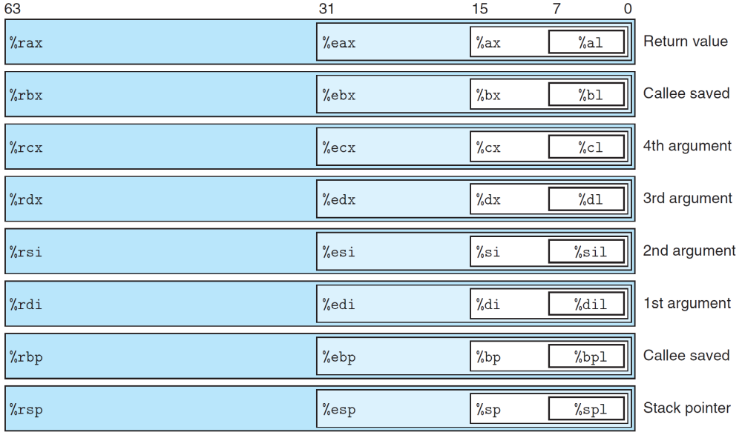
16 8-byte integer registers

Slide 29
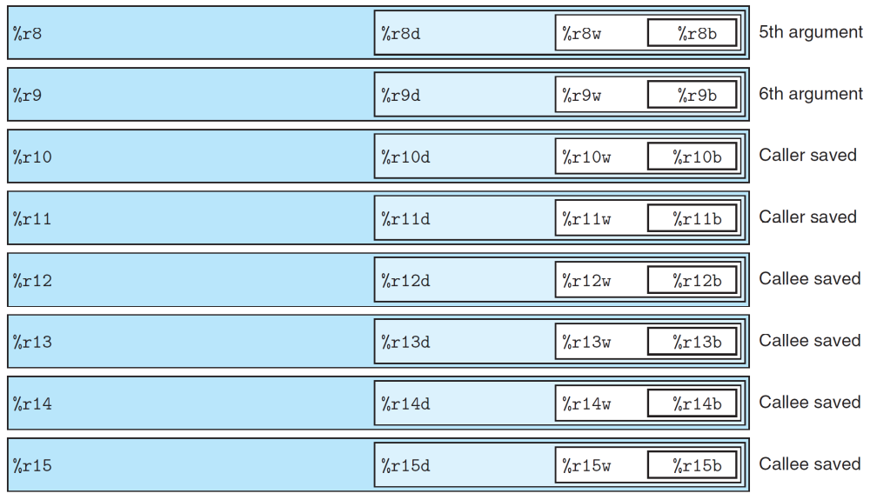
16 8-byte integer registers

Slide 30
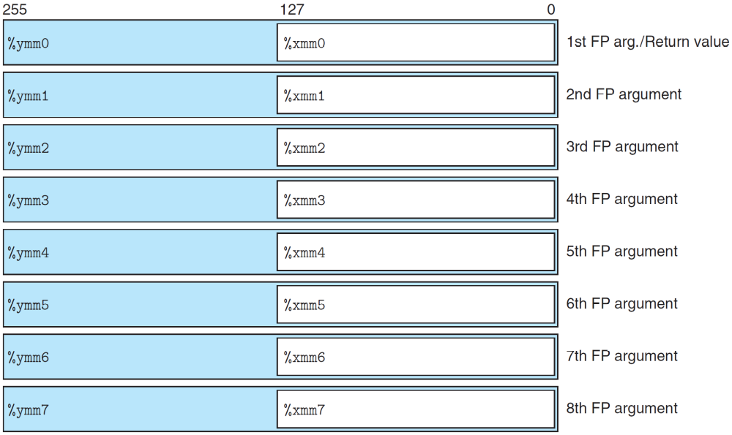
16 floating point registers

Slide 31
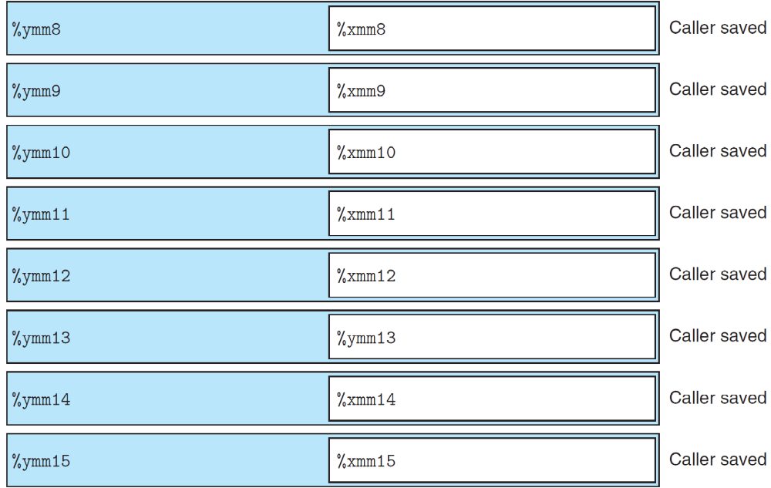
16 floating point registers

Slide 32
Operands (recall)
Counterparts in assembly languages
  Immediate ( constant )
  Register ( variable )
  Memory ( variable )
Example
  movq %rax, 8(%rbp)
  addq $4, %rax
register
memory
immediate

Slide 33
Express Operands in Assembly (Addressing Mode)
Immediate
  represents a constant
  The format is $imm ($4, $0xffffffffffffffff)
Registers
  Register mode r_{a}
    %rax
    The value stored in the register %rax
      Noted as R[r_{a}] (R[%rax])

Slide 34
Virtual spaces
A linear array of bytes
  each with its own unique address (array index) starting at zero
0xffffffffffff
0xfffffffffffe
0x2
0x1
0x0
… … … …
contents
addresses

Slide 35
Memory References
The name of the array is annotated as M
If addr is a memory address
M[addr] is the content of the memory starting at addr
addr is used as an array index
How many bytes are there in M[addr]?
  It depends on the context

Slide 36
Indexed Addressing Mode
An expression for
  a memory address (or an array index)
Most general form
  Imm(r_{b}, r_{i}, s)
  Constant “displacement” Imm: 1, 2, 4 or 8 bytes
  Base register r_{b}: Any of 64-bit integer registers
  Index register r_{i} : Any of 64-bit integer registers
  S: Scale: 1, 2, 4, or 8

Slide 37
Memory Addressing Mode
The address represented by the above form
  imm + R[r_{b}] + R[r_{i}] * s
It gives the value
  M[imm + R[r_{b}] + R[r_{i}] * s]

Slide 38
Addressing Mode
Type | Form | Operand value | Name
Immediate | $Imm | Imm | Immediate
Register | r_{a} | R[r_{a}] | Register
Memory | Imm | M[Imm] | Absolute
Memory | (r_{a}) | M[R[r_{a}]] | Indirect
Memory | Imm(r_{b}) | M[Imm+ R[r_{b}]] | Base+displacement
Memory | (r_{b}, r_{i}) | M[R[r_{b}]+ R[r_{i}]] | Indexed
Memory | Imm(r_{b}, r_{i}) | M[Imm+ R[r_{b}]+ R[r_{i}]] | indexed
Memory | (, r_{i}, s) | M[R[r_{i}]*s] | Scaled indexed
Memory | (r_{b}, r_{i}, s) | M[R[r_{b}]+ R[r_{i}]*s] | Scaled indexed
Memory | Imm(r_{b}, r_{i}, s) | M[Imm+ R[r_{b}]+ R[r_{i}]*s] | Scaled indexed

Slide 39
Address | Value
0x100 | 0xFF
0x108 | 0xAB
0x110 | 0x13
0x118 | 0x11
Register | Value
%rax | 0x100
%rcx | 0x1
%rdx | 0x3
Operand
Value
%rax
0x100
(%rax)
0xFF
$0x108
0x108
0x108
0xAB
260(%rcx,%rdx)
(0x108)0xAB
(%rax,%rdx,8)
(0x118)0x11

Slide 40
Understanding Machine Execution

Slide 41
Assembly Programmer’s View
Memory
Integer Registers
Addresses
Stack
Data
Float Registers
Heap
CPU
Instructions
DLLs
%rip
Heap
%eflag
Data
00400000
Text
00000000

Slide 42
Programmer-Visible States
Program Counter(%rip)
  Address of the next instruction
Register File
  Heavily used program data
  Integer and floating-point

Slide 43
Programmer-Visible States
Conditional code register (%eflags)
  Hold status information about the most recently executed instruction
  Implement conditional changes in the control flow
Virtual Memory

Slide 44
Assembly Instructions and their Execution Mode
Instruction
  Performs only a very elementary operation
  Typically operates data stored in registers
  Transfers data between memory and a register
Program
  is a sequence of instructions
Sequential execution mode
  Normally one by one in sequential
  Conditionally branch to a new instruction address
multstore: pushq %rbx movq %rdx,%rbx call mult2 movq %rax, (%rbx) popq %rbx ret

Slide 45
Relocatable Object Code
53 48 89 d3 e8 00 00 00 00 48 89 03 5b c3 | Obtain with command gcc –Og -c mstore.c Relocatable object file mstore.o
Notes:
W 87

Slide 46
Executable Object Code
#include <stdio.h> void mulstore(long, long, long*) int main() { long d; multstore(2, 3, &d); printf(“2 * 3 --> %d\n”, d); return 0; } long mult2(long a, long b) { long s = a * b ; return s; }
Notes:
W 87

Slide 47
Executable Object Code
Disassembly of function multitore in binary file mstore.o 0000000000400540<multstore>: 400540: 53 push %rbx 400541: 48 89 d3 mov %rdx, %rbx 400544: e8 42 00 00 00 callq 40058b<mult2> 400549: 48 89 03 mov %rax, (%rbx) 40054c: 5b pop %rbx 40054d: c3 retq
Obtain with command gcc –Og –o prog main.c mstore.c objdump –d prog
Notes:
W 87

Slide 48
Understanding Machine Execution
Where the sequence of instructions are stored?
  In virtual memory
  Code area
How the instructions are executed?
  %rip stores an address of memory,
  from the address, machine can read a whole instruction once
  then execute it
  increase %rip
    %rip is also called program counter (PC)

Slide 49
Code Layout
memory invisible to
user code
kernel virtual memory
Linux/x86
process
memory
image
Read/write data
Read only data
Read only code
%rip
0x400000
forbidden

Slide 50
Sequential execution
0000000000400540<multstore>:
400540: 53 push %rbx
400541: 48 89 d3 mov %rdx, %rbx
400544: e8 42 00 00 00 callq 40058b<mult2>
400549: 48 89 03 mov %rax, (%rbx)
40054c: 5b pop %rbx
40054d: c3 retq
kernel virtual memory
Read/write data
Read only data
Read only code
0x400540
%rip
forbidden

Slide 51
Sequential execution
 | c3 | ret
40054c | 5b | pop %rbx
 | 03
 | 89
 | 48 | mov %rax, (%rbx)
400548 | 00
 | 00
 | 00
 | 42
400544 | e8 | callq 40058b
 | d3
 | 89
 | 48 | mov %rdx, %rbx
400540 | 53 | push %rbx
400540: 53 push %rbx
400541: 48 89 d3 mov %rdx, %rbx
400544: e8 42 00 00 00 callq 40058b<mult2>
400549: 48 89 03 mov %rax, (%rbx)
40054c: 5b pop %rbx
40054d: c3 retq
PC
40 05 4d
PC
40 05 4c
PC
40 05 49
PC
40 05 44
PC
40 05 41
PC
40 05 40

Slide 52
Data layout
Object model in assembly
  A large, byte-addressable array
  No distinctions even between signed or unsigned integers
  Code, user data, OS data
  Run-time stack for managing procedure call and return
  Blocks of memory allocated by user(heap)

Slide 53
Data Layout
memory invisible to
user code
kernel virtual memory
(for OS)
Stack
Downward growth
%rsp
Heap
Read/write data
Linux/x86 process
memory image
Read only data
Read only code
%rip
0x400000
forbidden

Slide 54
Source Code and Assembly Code
//C code long mult2(long, long); void multstore(long x, long y, long *dest) { long t = mult2(x, y); *dest = t; }
Assembly file mstore.s multstore: pushq %rbx movq %rdx,%rbx call mult2 movq %rax, (%rbx) popq %rbx ret
On the code area
*dest:
On the data area

